Slide 1
EBOX: Our advice for set up so far….
Need Two drapes & scissors. Cut both drapes in half, need three halves per procedure
Save spare half and use for next procedure
The three halves are then referred to as
1st drape
2nd drape
3rd drape
This is just based on our experience of 12 cases since mid-April so please feedback experience via the forms (and hopefully website soon)

Slide 2
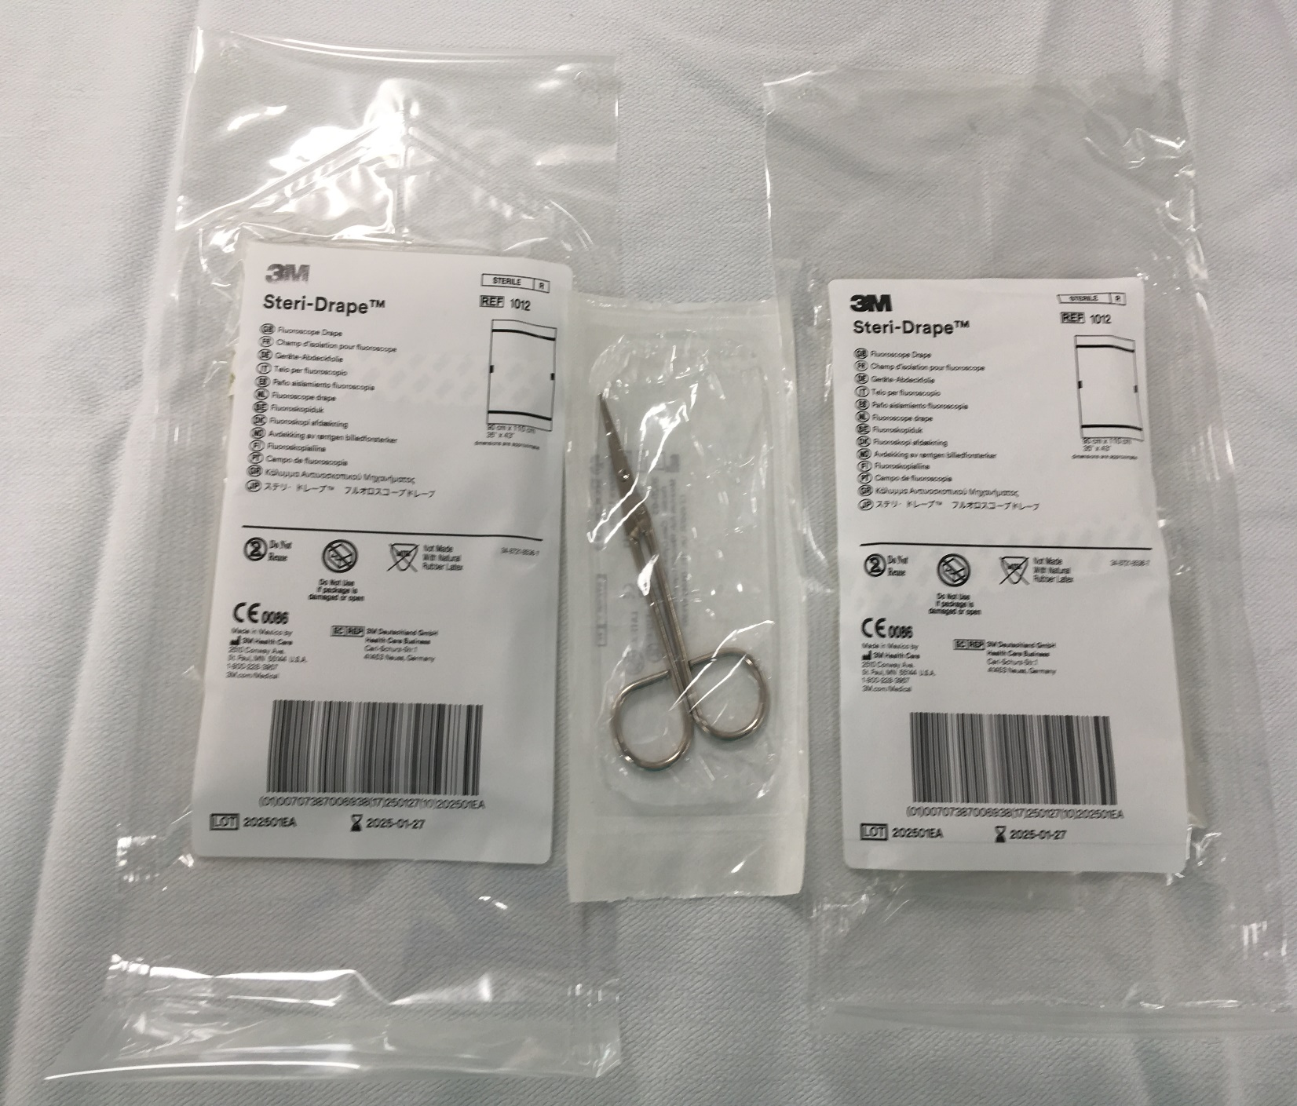
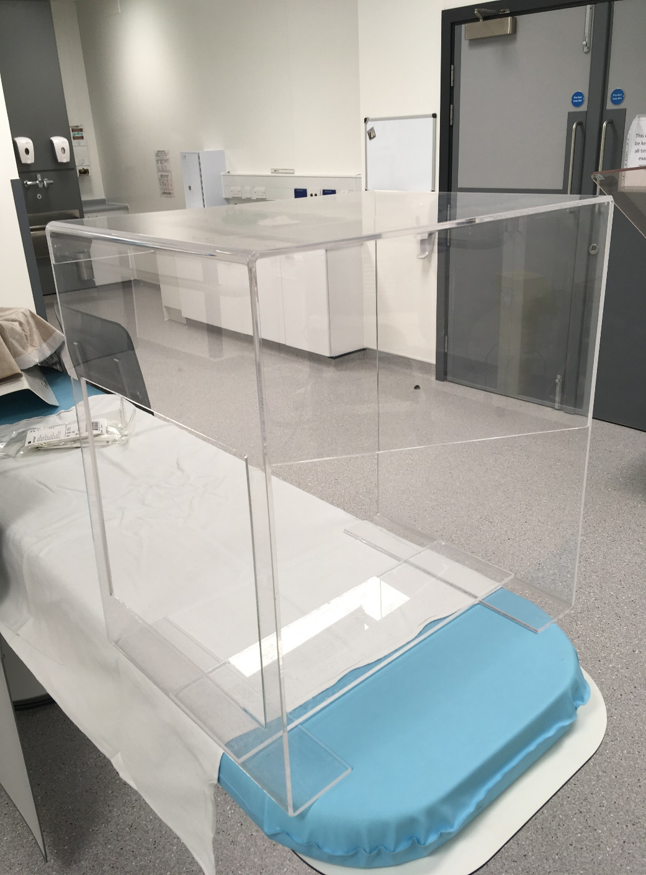

Slide 3
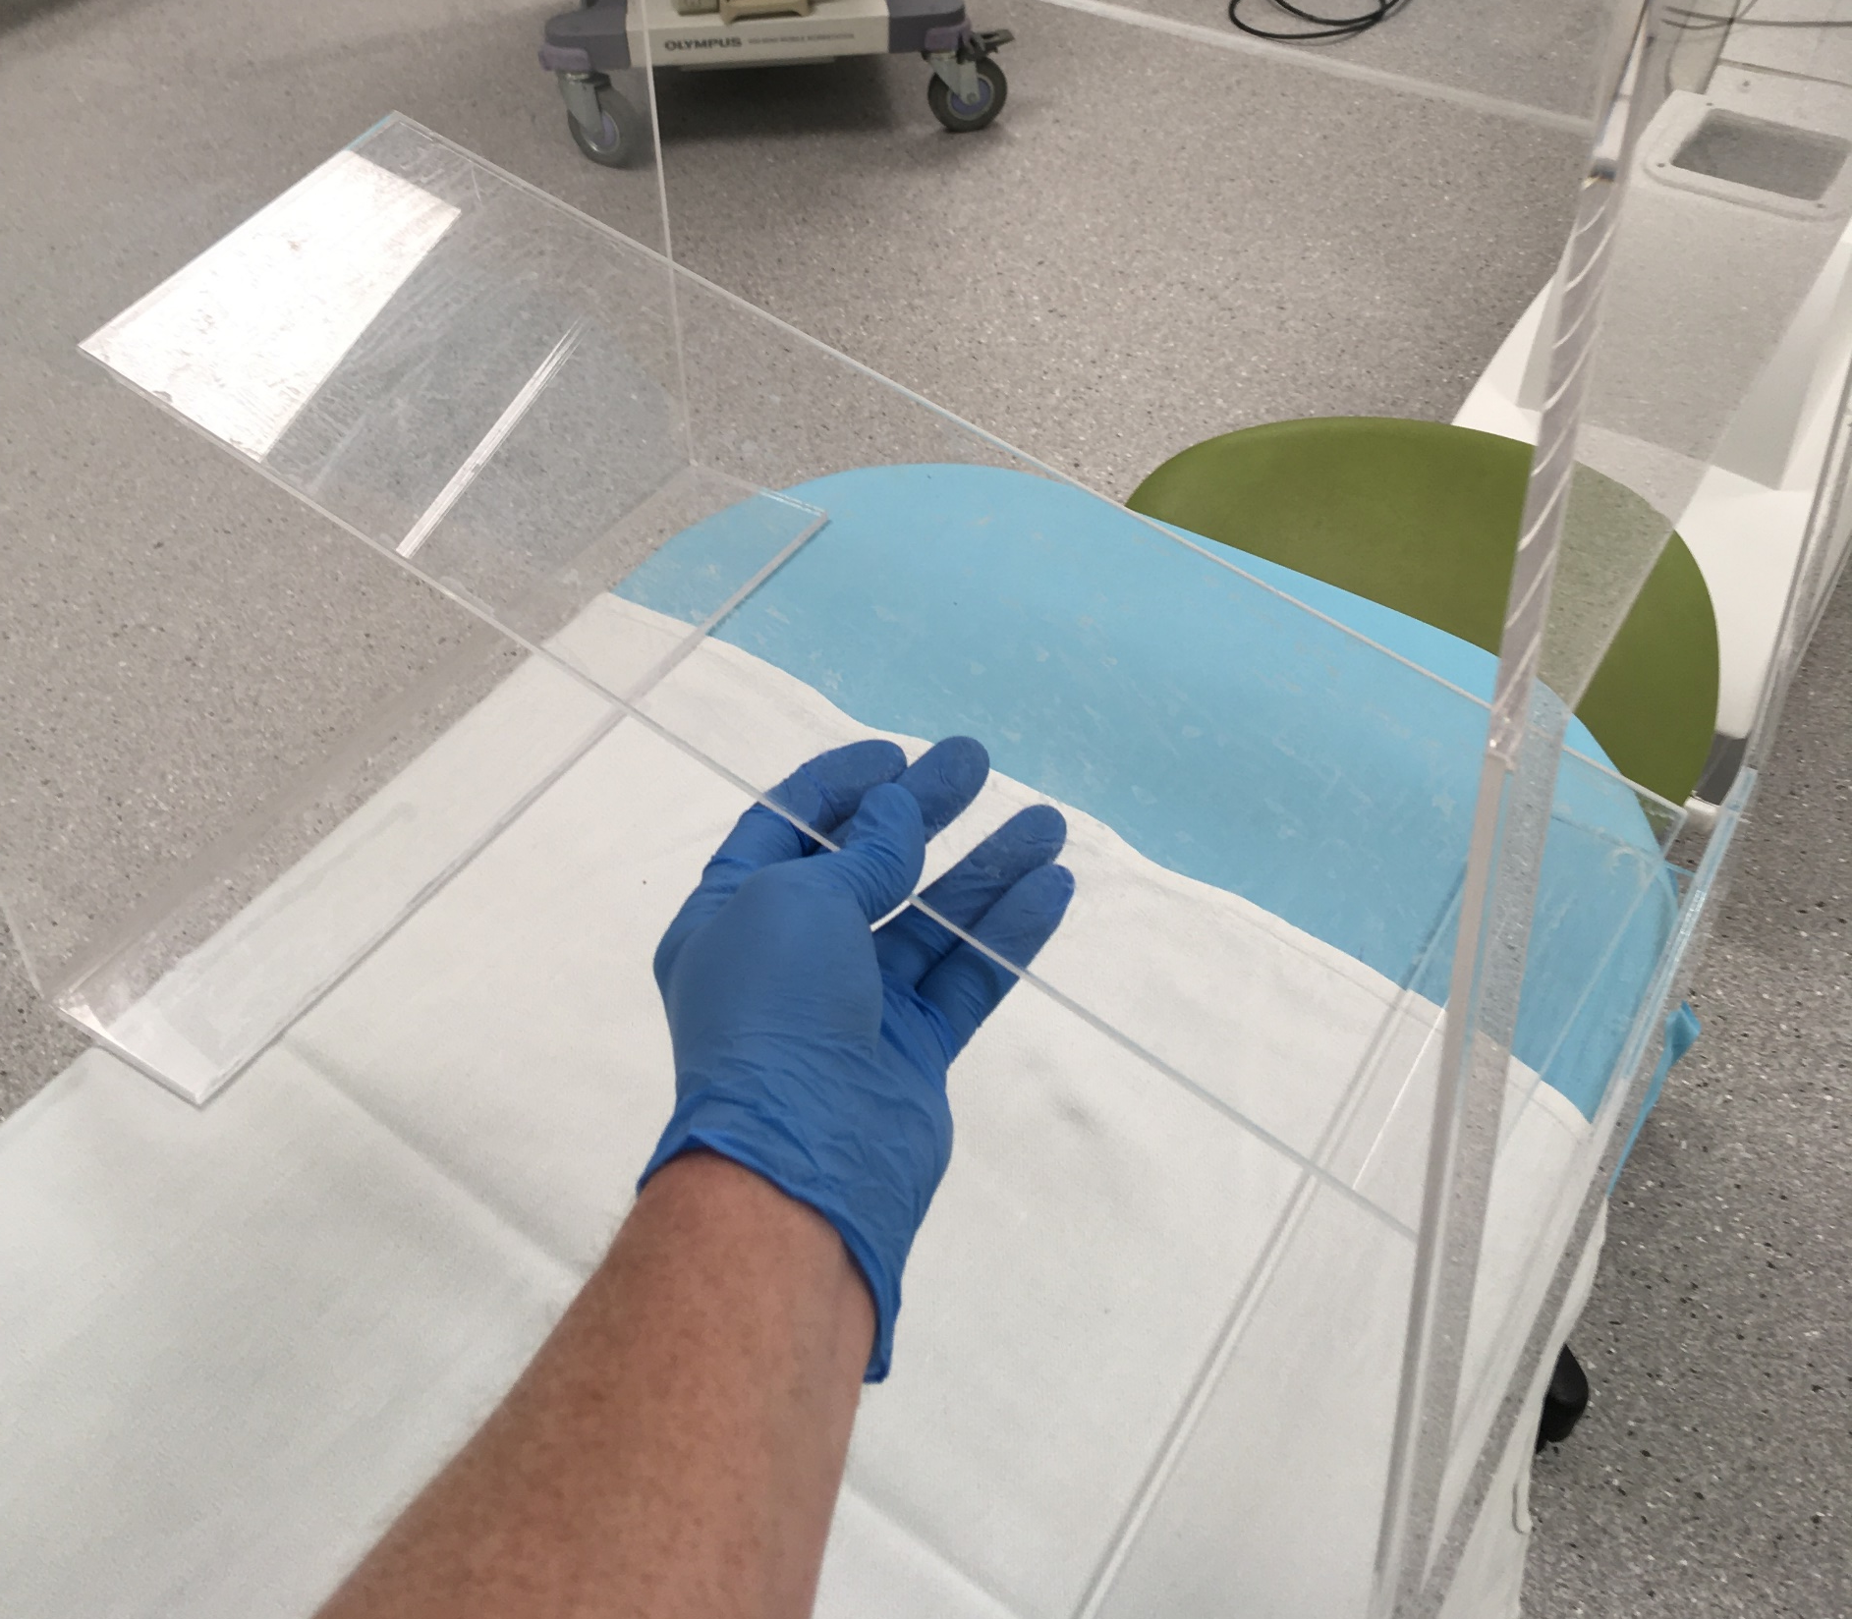
Acrylic sheet
placed across
inward
facing flanges
For stability

Slide 4

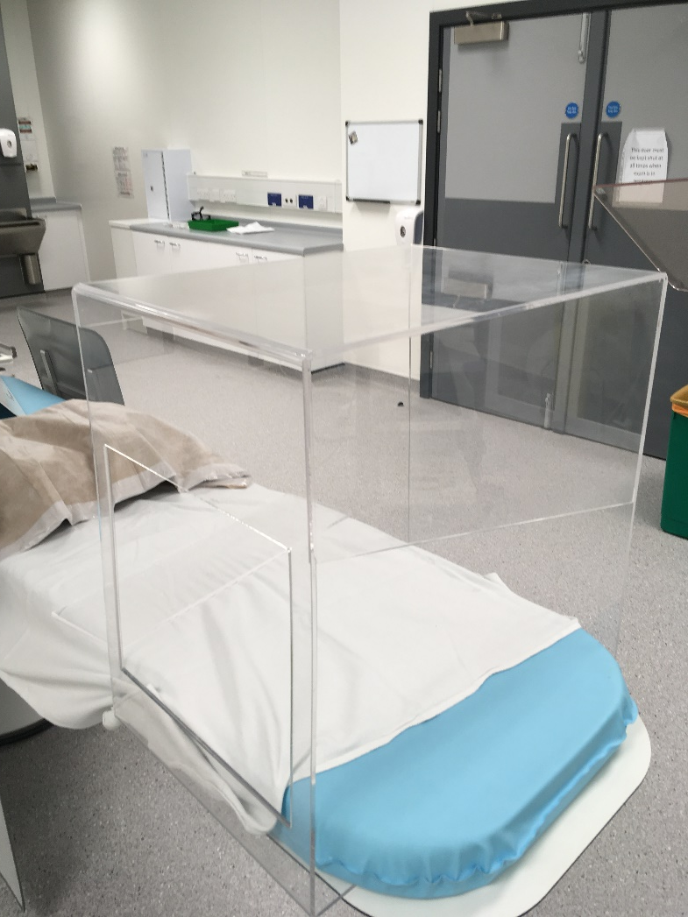
Use EBOX on top or under the mattress

Slide 5
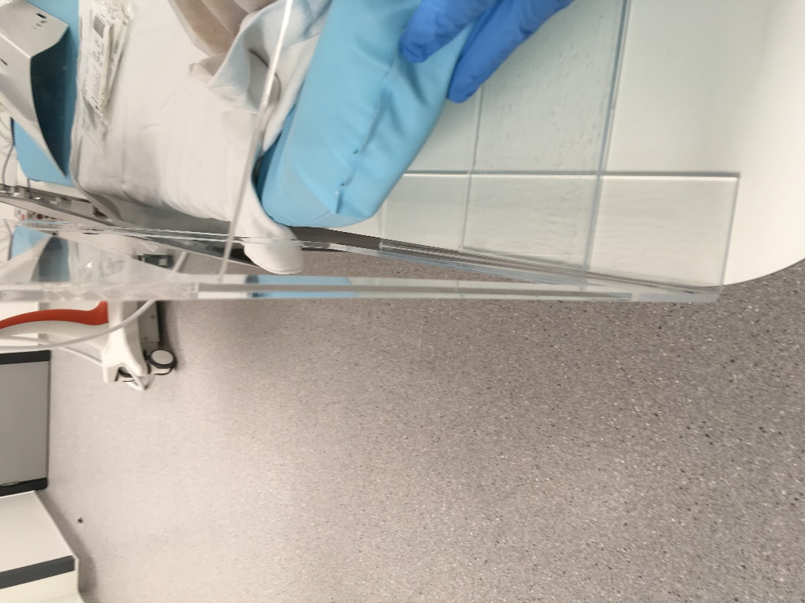
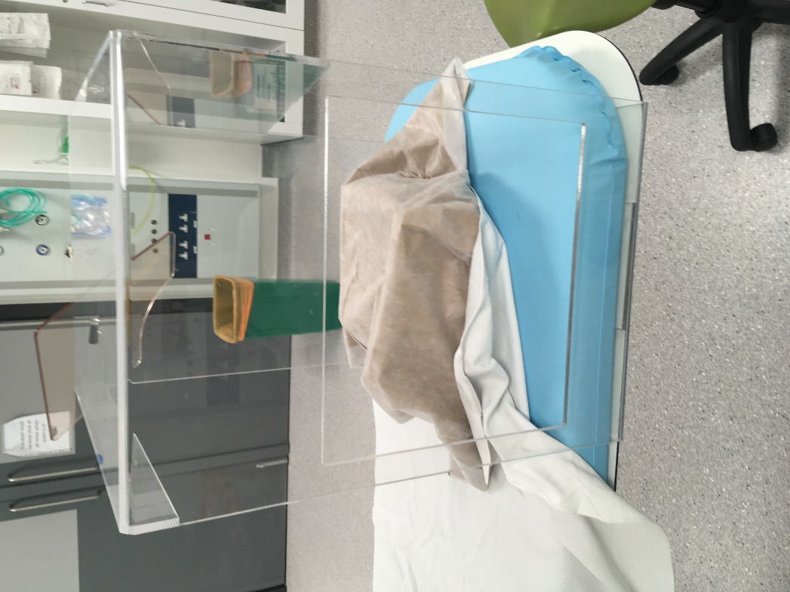
Under mattress on ERCP table

Slide 6
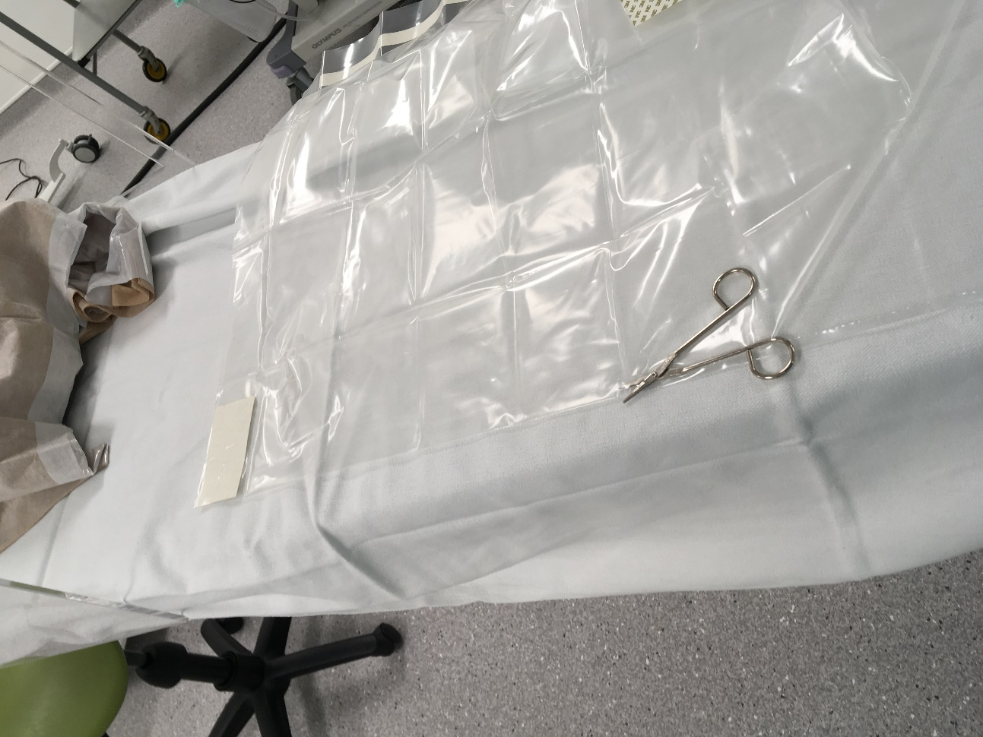
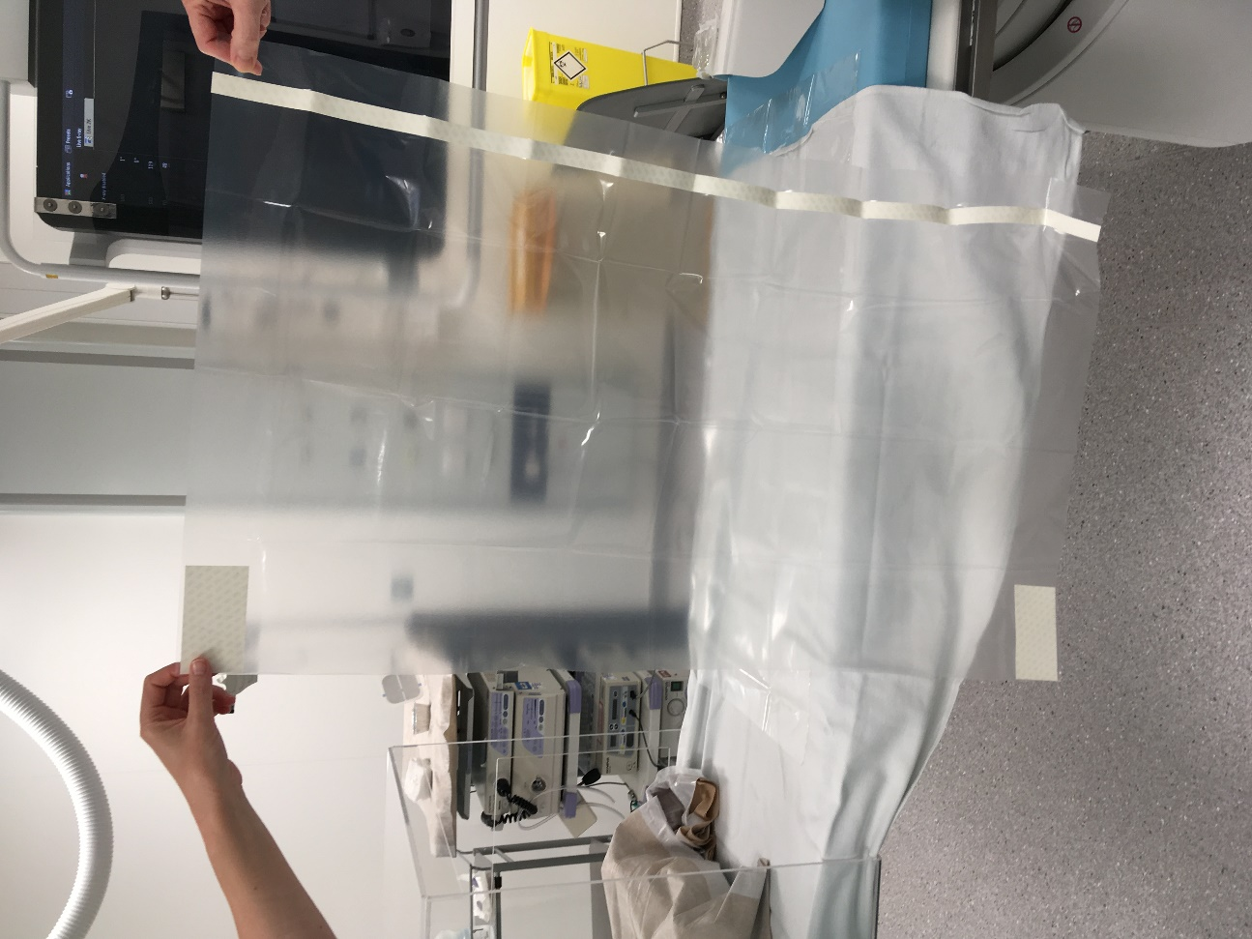
Cut drape into two symmetrical halves

Slide 7
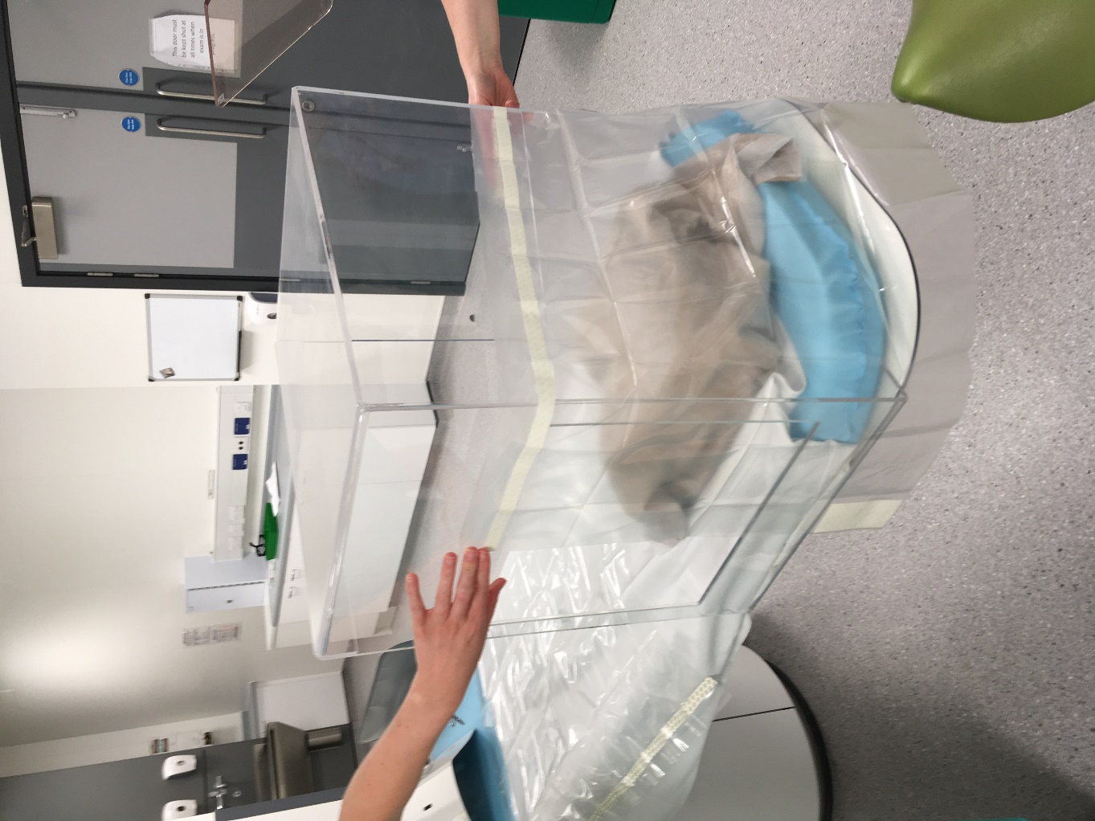
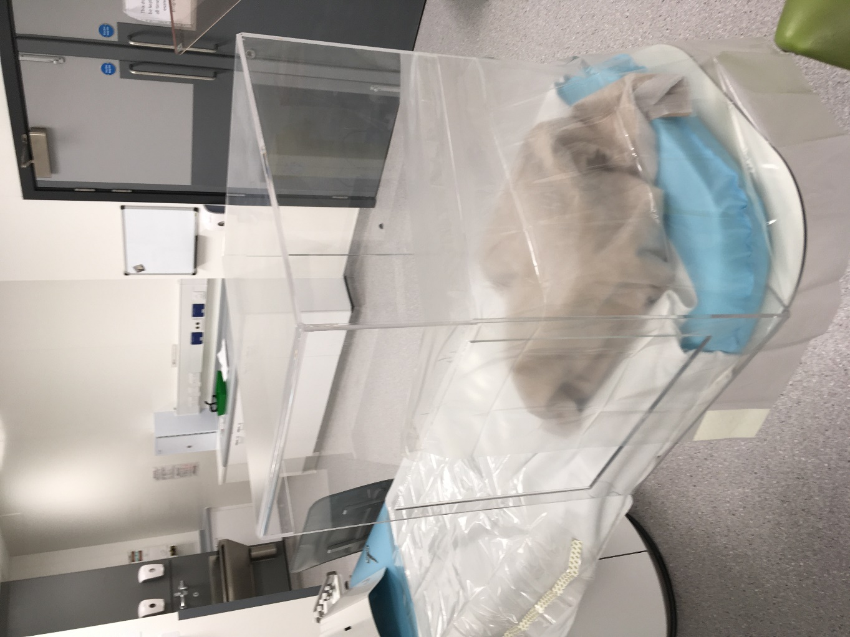
1st drape –fully cover assistant’s access window, and halfway across endoscopist’s access window. Peel off, and stick

Slide 8
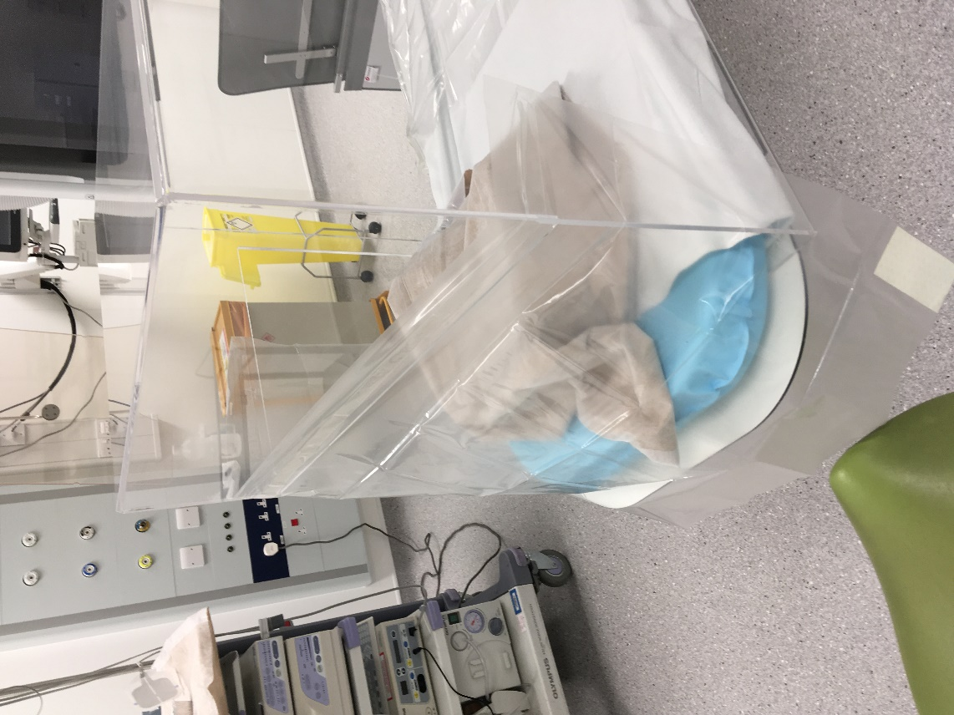
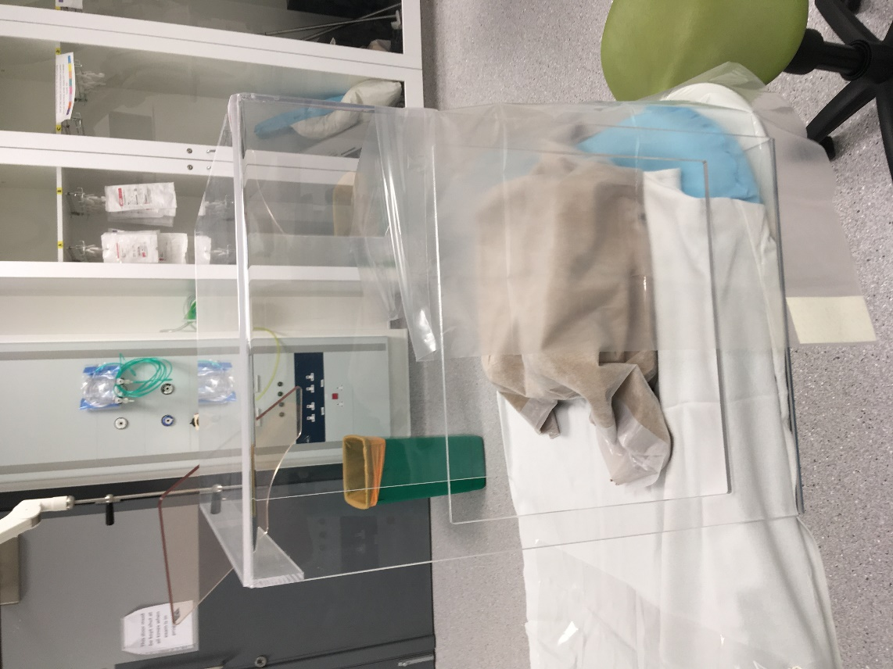
1st Drape fixed and view from:
The back
And head
End
Endoscopists
view

Slide 9
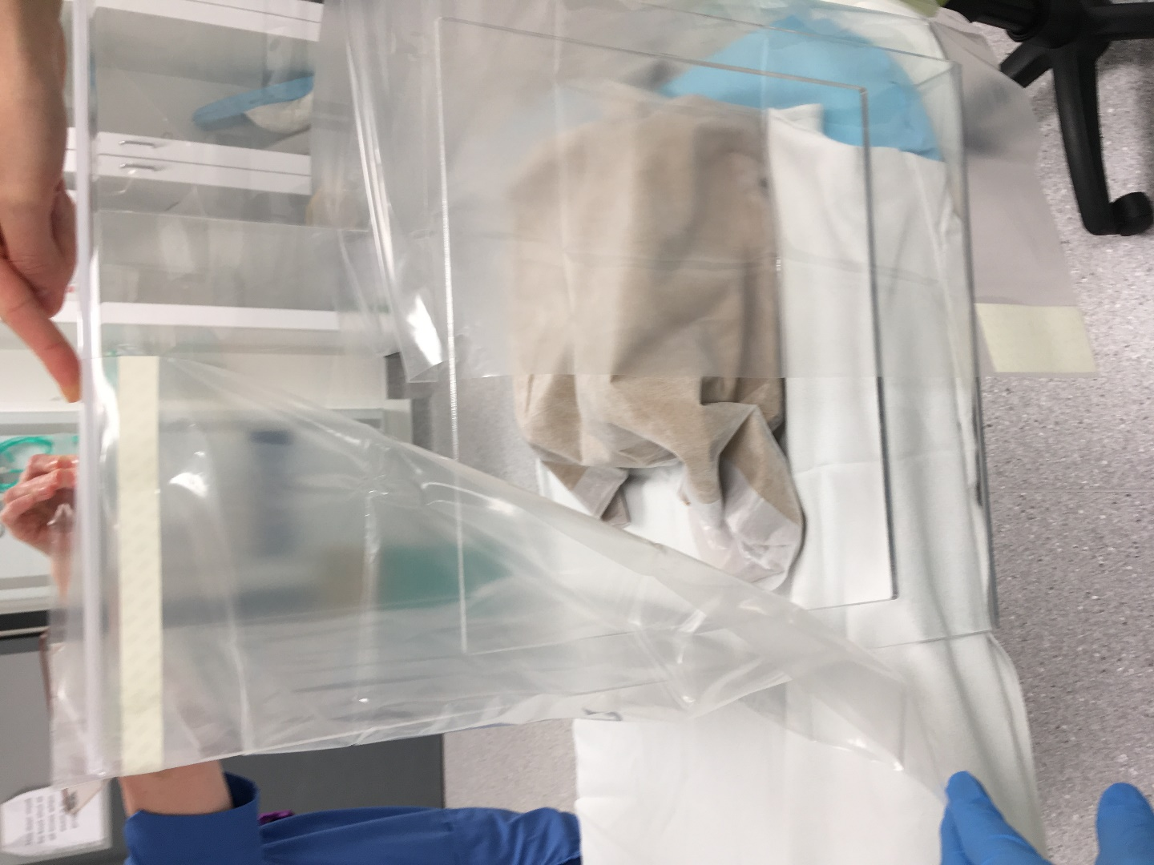
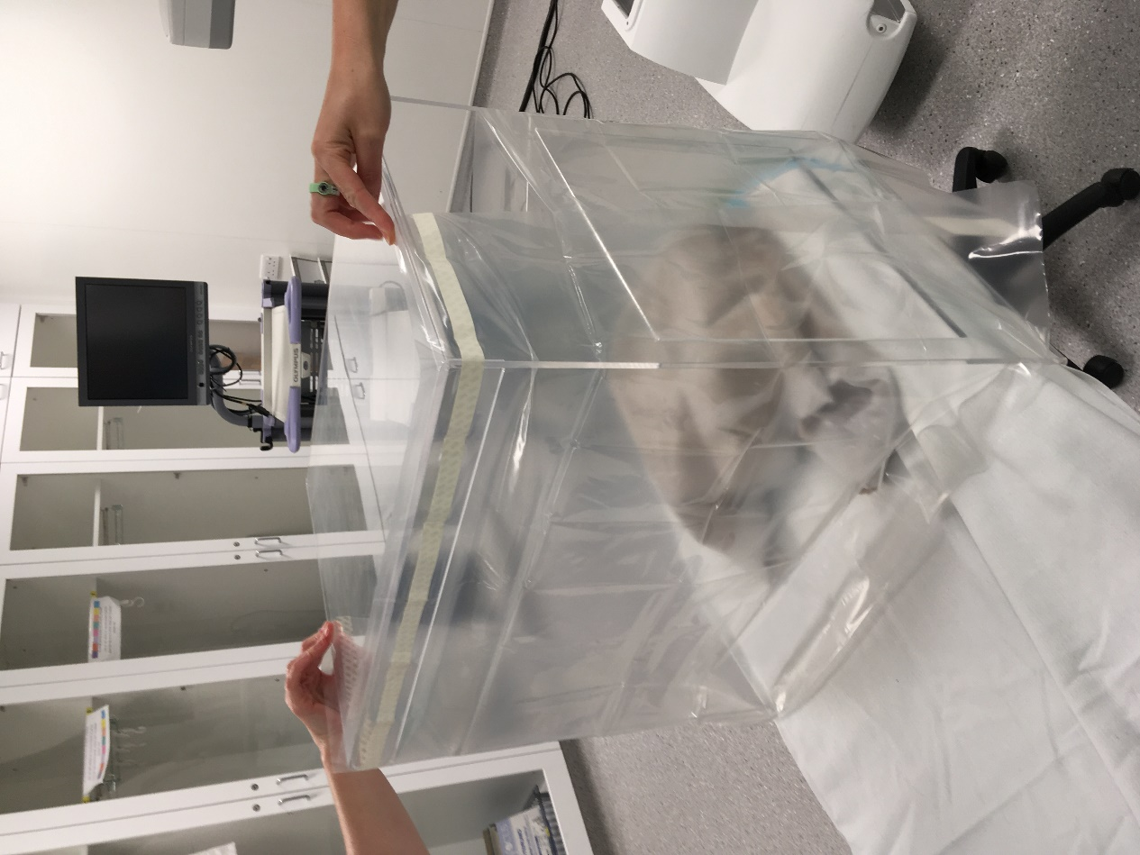
2nd drape - position

Slide 10
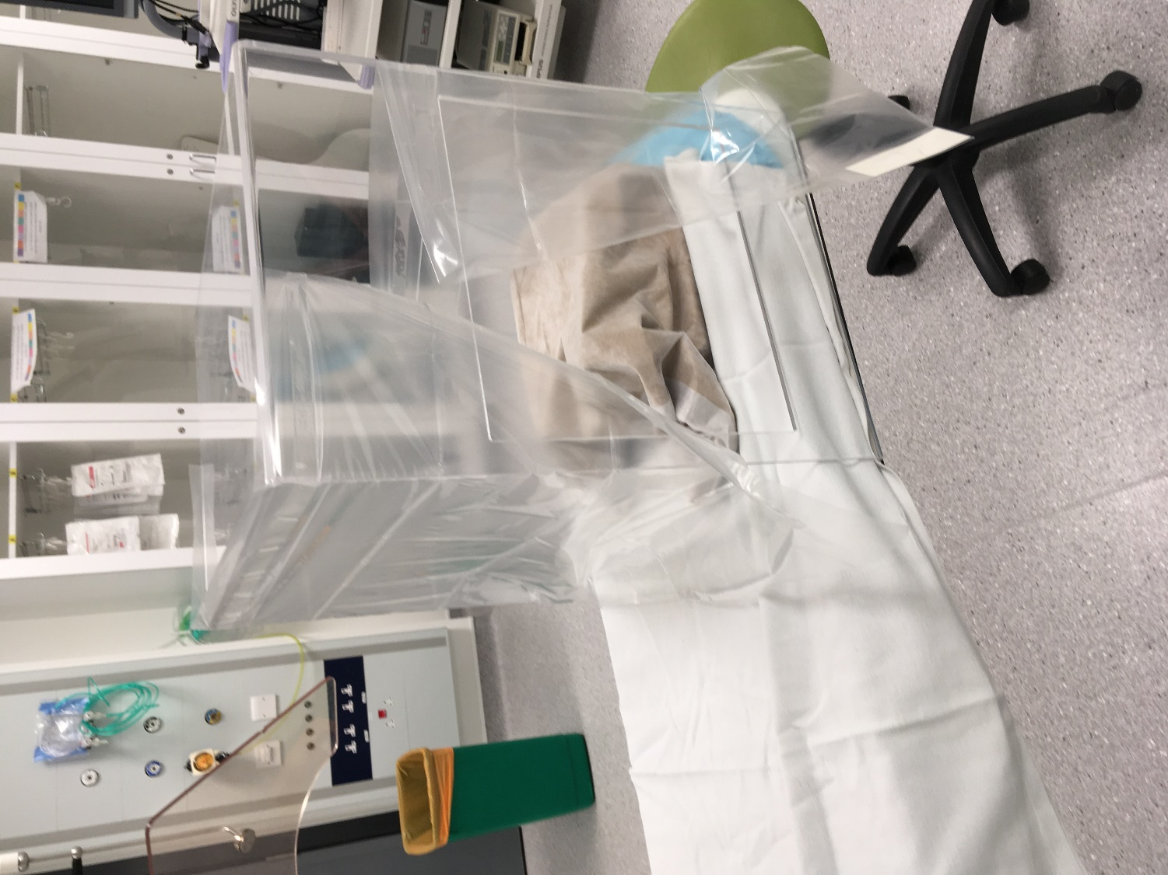
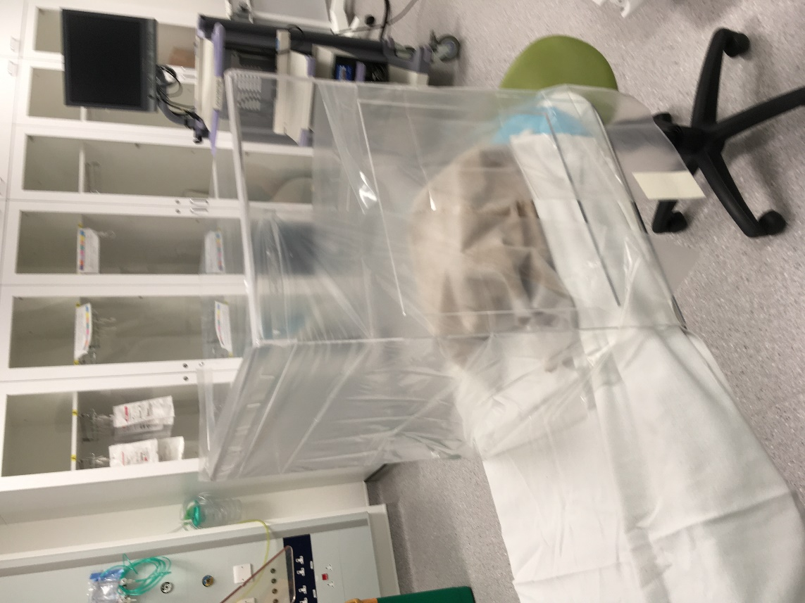
…then fix Curtain effect for endoscopist’s window

Slide 11
Two drapes in position:
We have, for last 3 cases, pre-prepared the box to this stage, folded drapes UP and onto the lid, then slid it over the patient with the flanges under the mattress
Before, we slid the undraped box into position.
We don’t expect patients to crawl into the box!
For ERCP, with patient in position, position the image intensifier and Re-adjust box position if necessary by sliding
TIP: Use Image intensifier in landscape not portrait, quick flash screen to test position

Slide 12
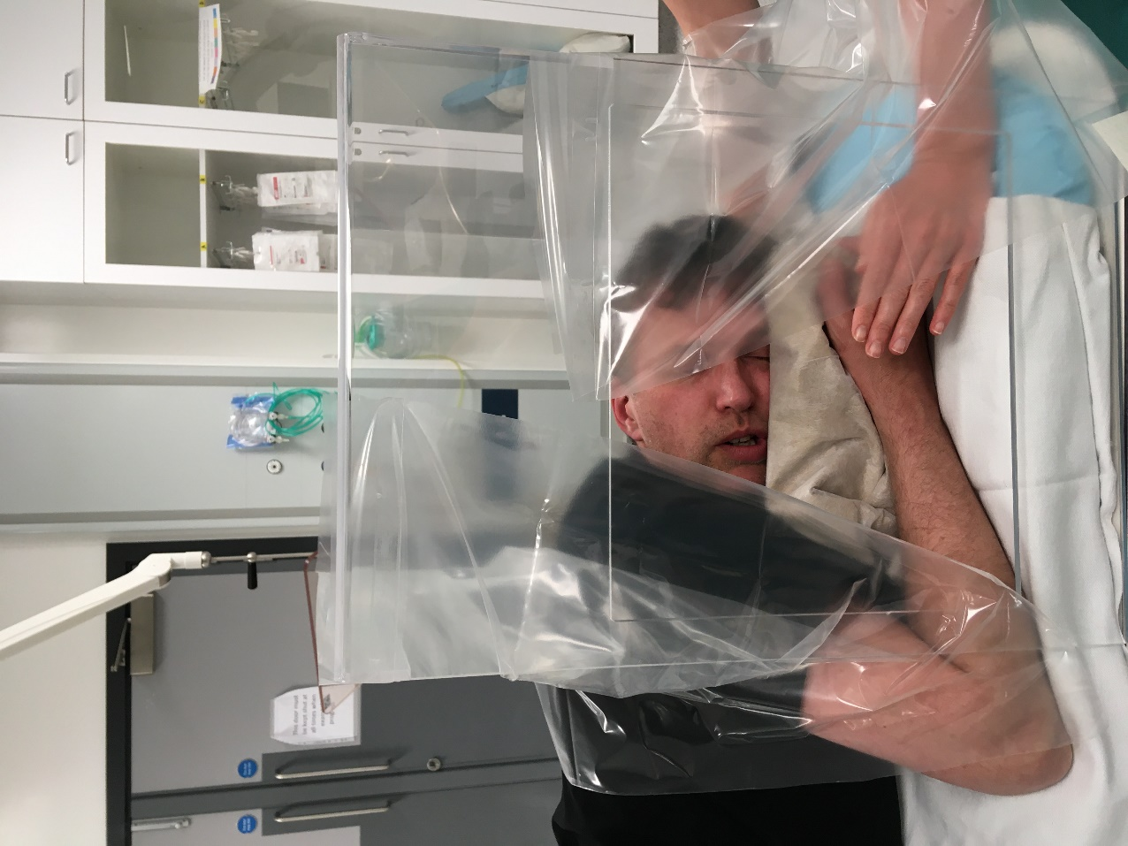
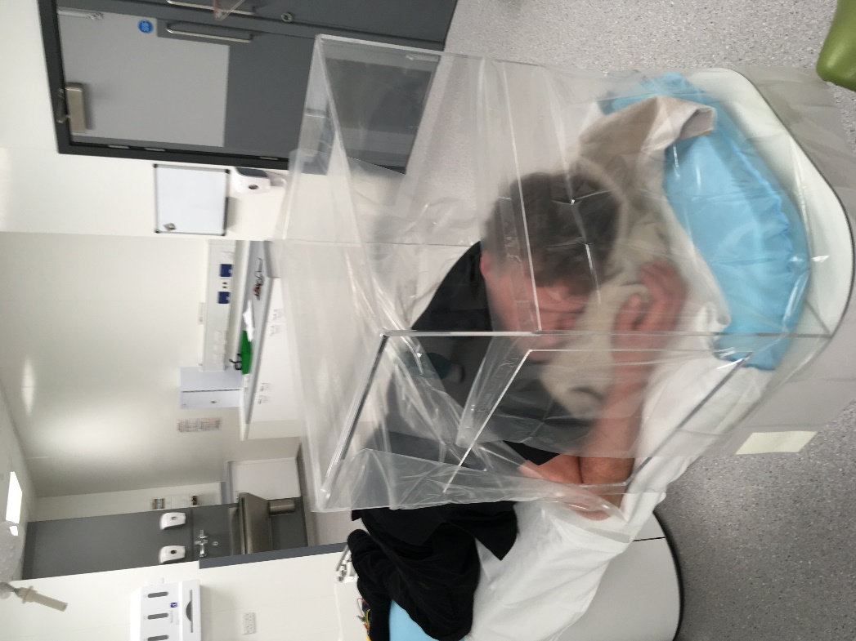
Thanks for modelling Jason!

Slide 13
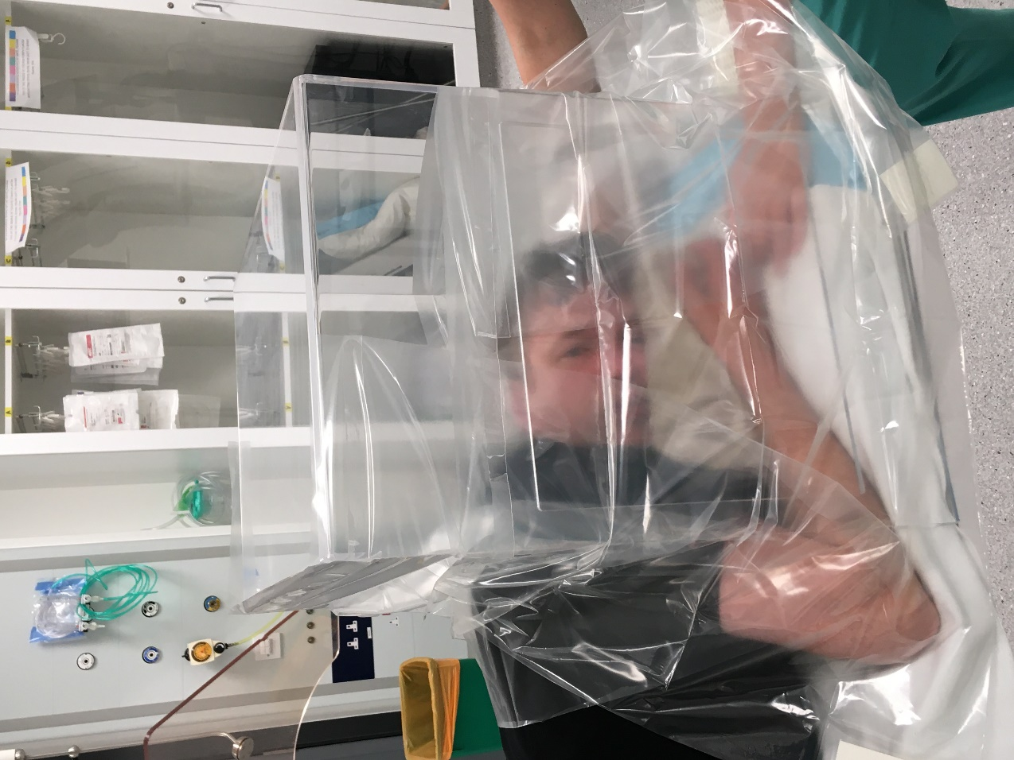
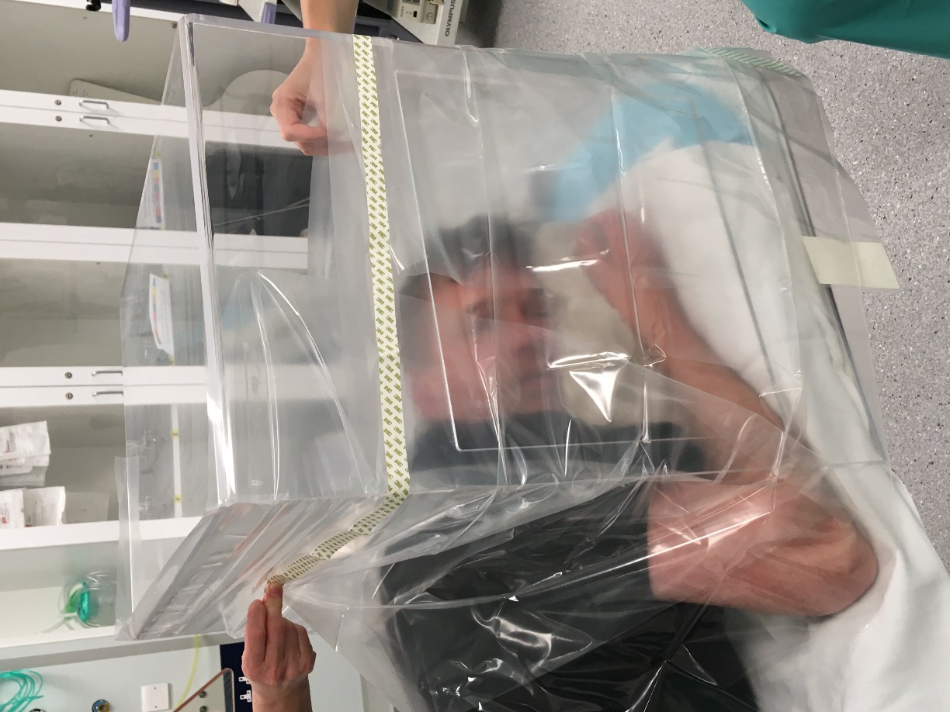
3rd and final drape across endoscopists window
Position
…and fix

Slide 14
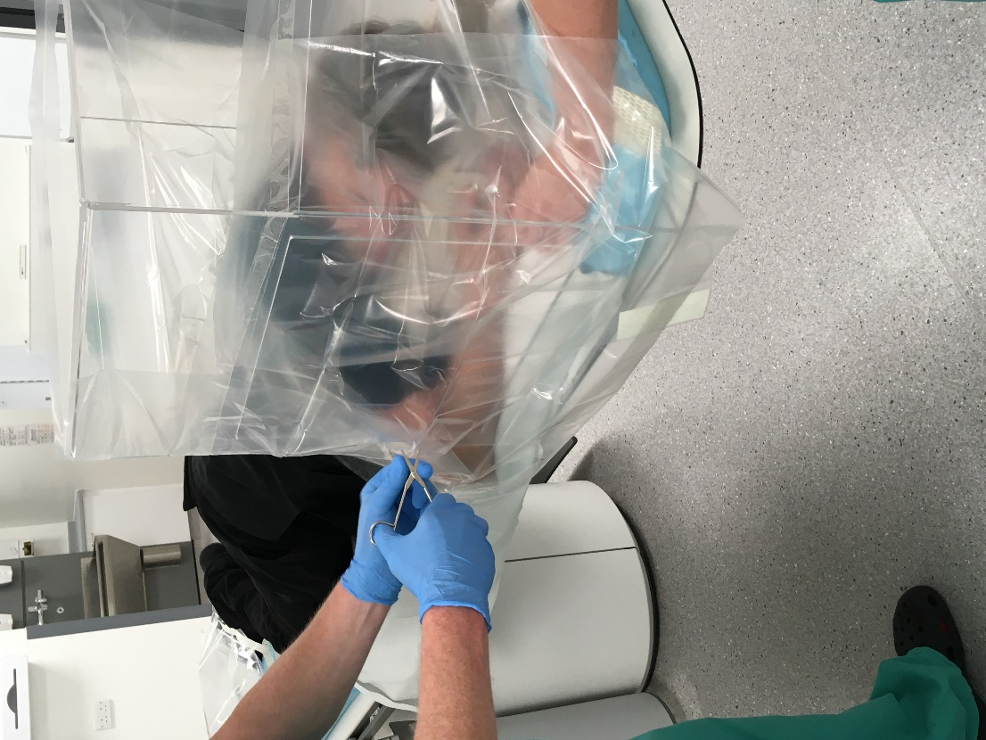
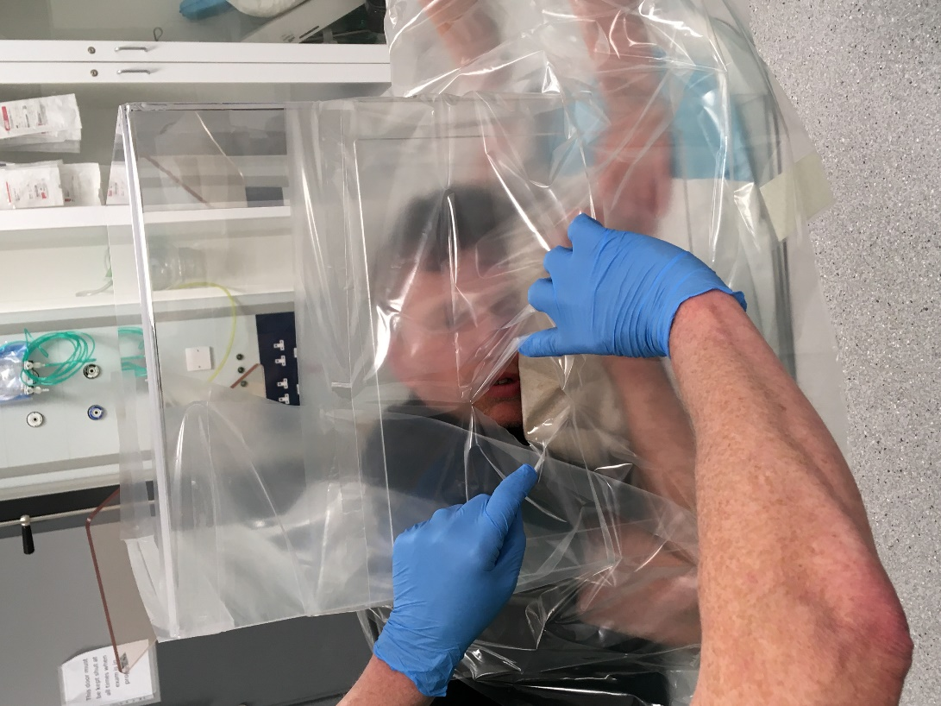
Cut access hole, big enough for your hand at the point where best for intubation – the endoscopist MUST do this
Scissors
Hole

Slide 15
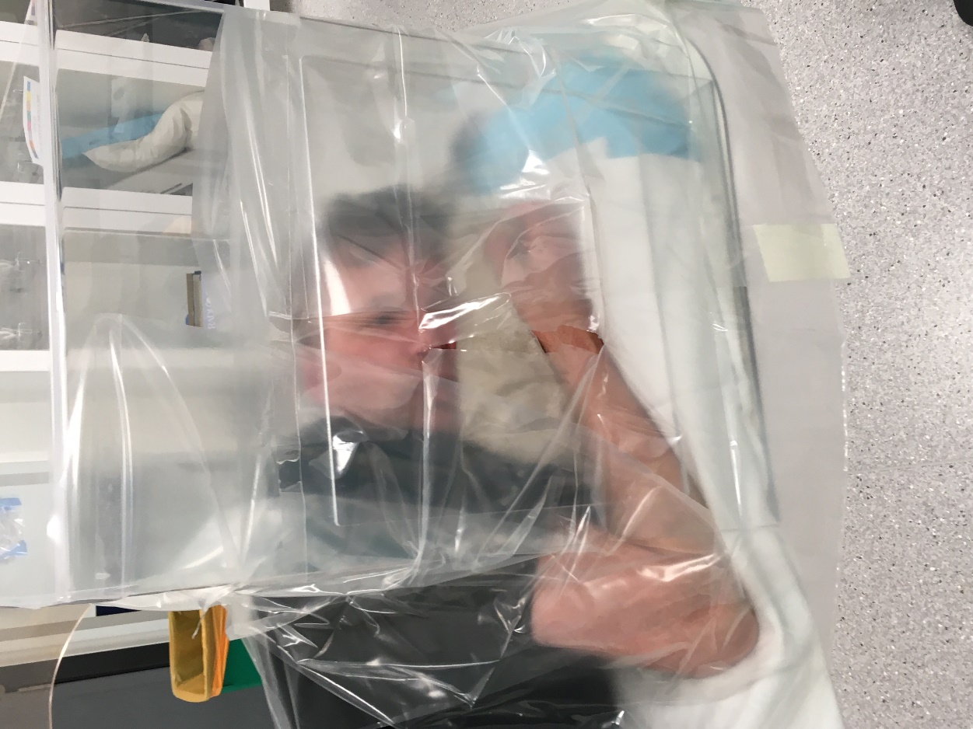
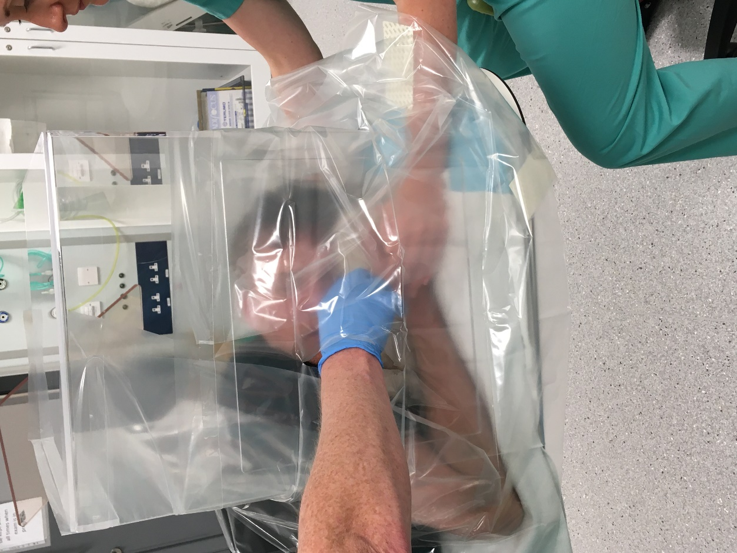
Can intubate with right hand inside the box but now I prefer to keep it outside altogether. Cover biopsy channel inlet with swap during wire exchanges

Slide 16
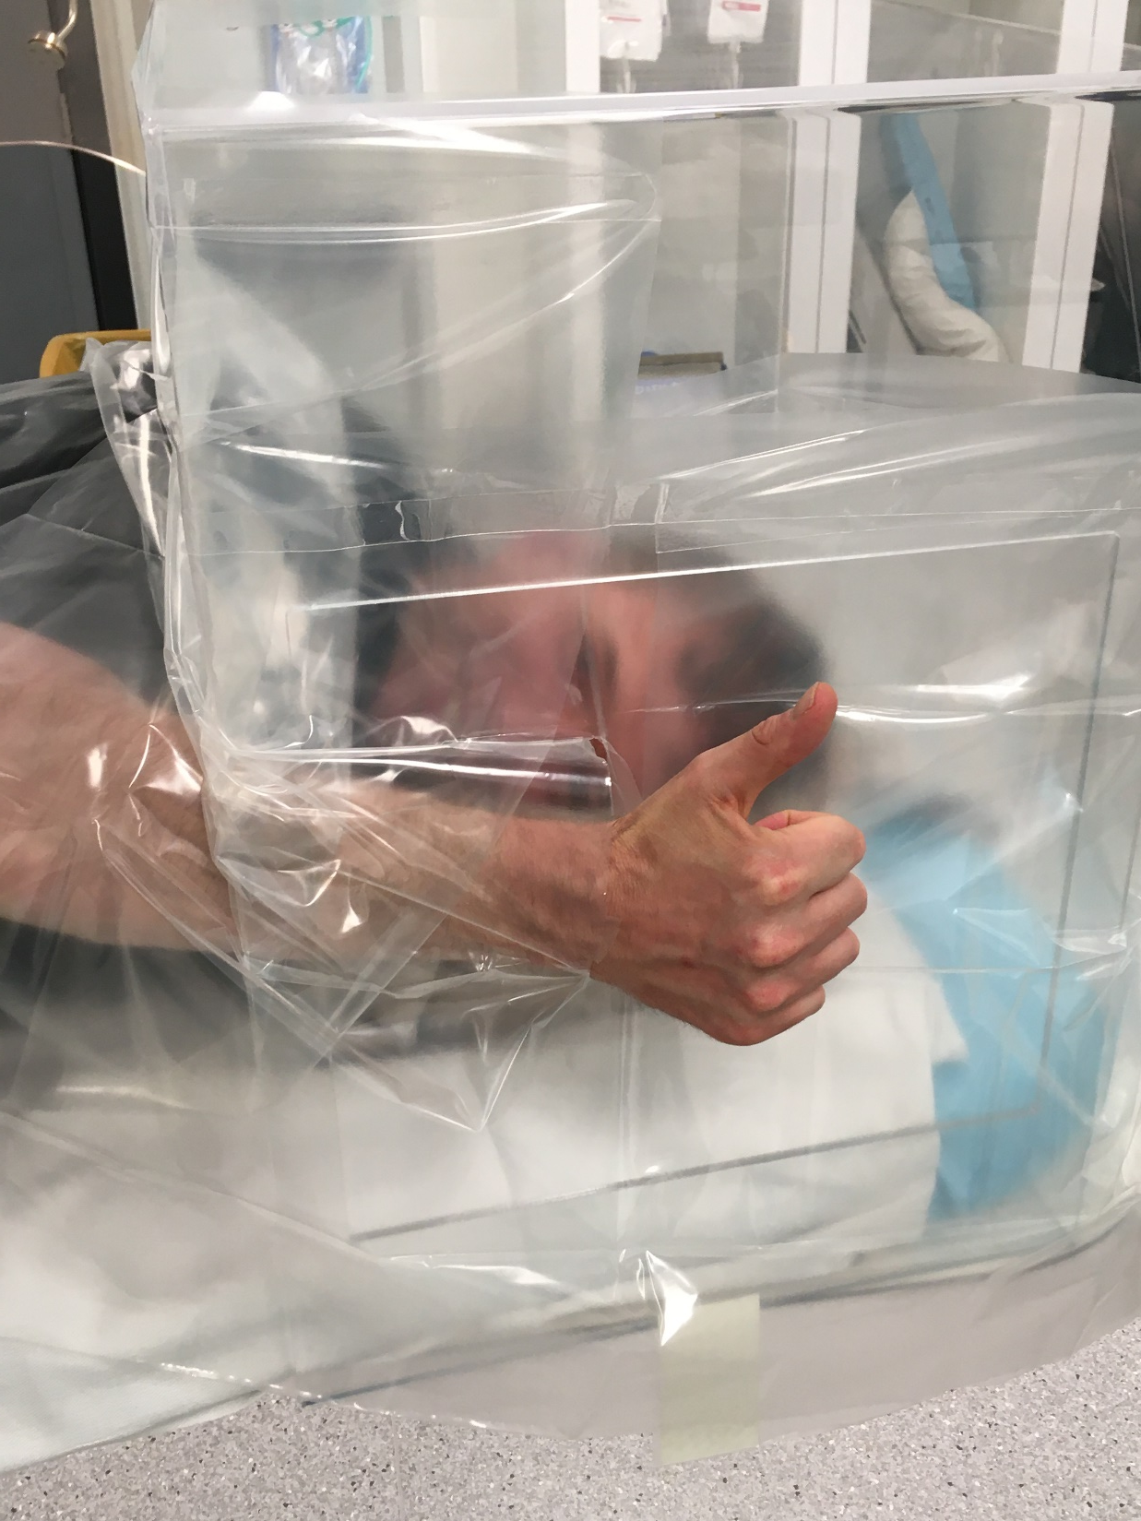
It is worth persisting with, and very easy when you get used to it
Please think about feedback. We will circulate simple tick box forms- web based or word document very soon
The box protects against droplets but you still need PPE for AGPs at the moment
Good luck!
Ashley Roberts, Rob Mcleod, Neil Warren and our wonderful staff in UHW Radiology

